Slide 1
Lexis diagram
9. 11. 2022
Bety Ukolova (ukolovae@natur.cuni.cz)

Slide 2

Motivation
$$mortality rates= \frac{Deaths}{Population exposure}$$

Slide 3
Outline
Time in demography
Lexis diagram
Sets of events
Approaches in demographic analysis
Sets of points
Exercise 1
Estimation of initial population and exposures
Exercise 2

Slide 4
Readings
TESÁRKOVÁ, Klára Hulíková; KURTINOVÁ, Olga. Lexis in Demography. Springer International Publishing, 2018. Pages 11–14 & 46–48.
CASELLI, Graziella; VALLIN, Jacques; WUNSCH, Guillaume. Demography: Analysis and Synthesis, Four Volume Set: A Treatise in Population. Elsevier, 2005. Part II, Chapter 6, pages 55–61.
ROWLAND, Donald T. Demographic methods and concepts. OUP Oxford, 2003.
https://papp.iussp.org/sessions/papp101_s02/PAPP101_s02_090_010.html
RAU, Roland, et al. Visualizing mortality dynamics in the Lexis diagram. 2017. Online: https://link.springer.com/content/pdf/10.1007/978-3-319-64820-0.pdf
More sources in reading list

Slide 5
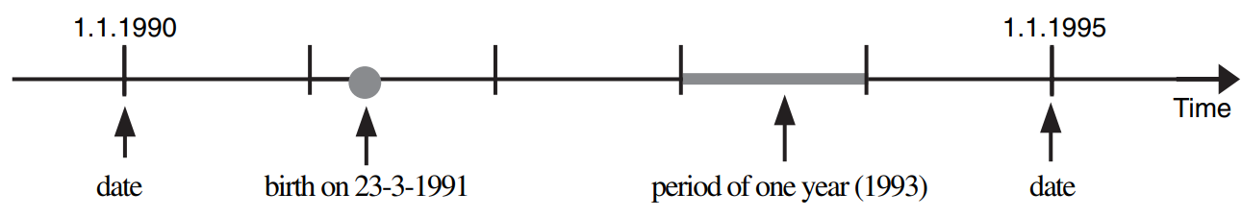
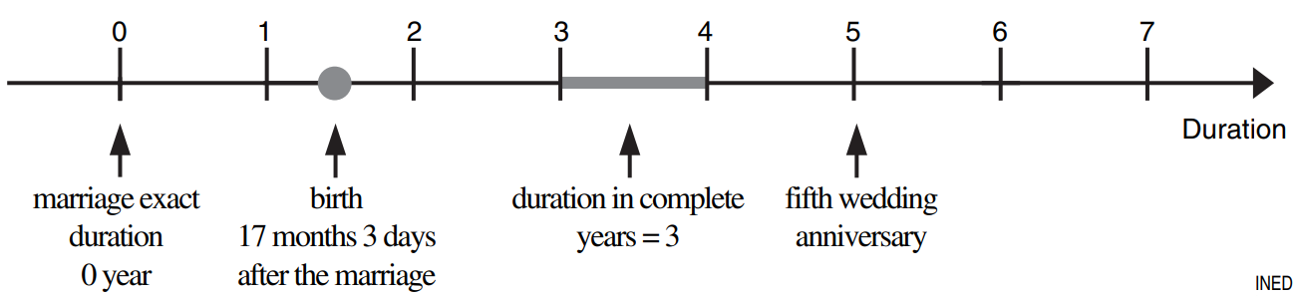
Time in Demography
Time is the most important variable in demography
We distinguish between absolute time and relative time.
Absolute time = exact position on the timeline (dates of events)
Relative time = duration, time elapsed between two events, f. e: time spend in marriage ~ time elapsed between marriage and divorce/death etc., age ~ time spend between birth and death
Example: Todays date: 9. 11. 2022
Age of a person born on 8. 11. 2000 is
22 years and 1 day (exact age)
22 years (completed age)
22 years (reached age)
Age of a person born on 10. 11. 2000 is
21 years and 364 days (exact age)
21 years (completed age)
22 years (reached age)
↑ Schema of absolute and relative time [2]

Slide 6
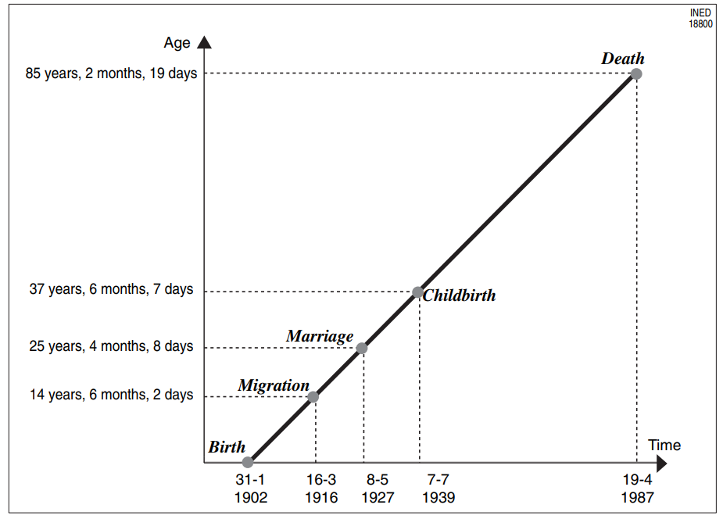
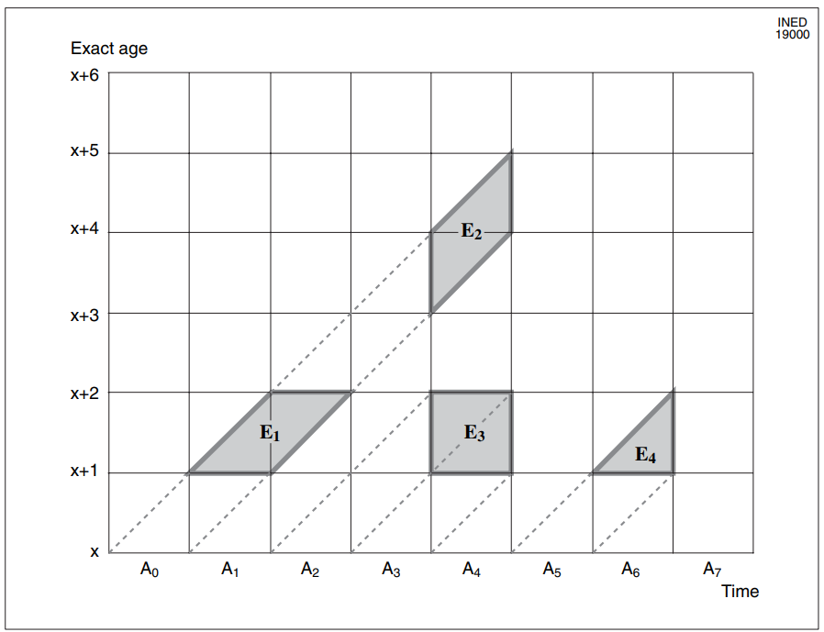
Lexis diagram
Lexis diagram is a way to express the relationship between all dimensions of the time in one (coordinate) system
Age
Life line
Calender time
Representation, on a Lexis diagram of a lifeline, with an event point (migration, marriage) and a terminal death point [2] ↑
Different possible annual classification modes in Lexis diagram [2] ↑

Slide 7
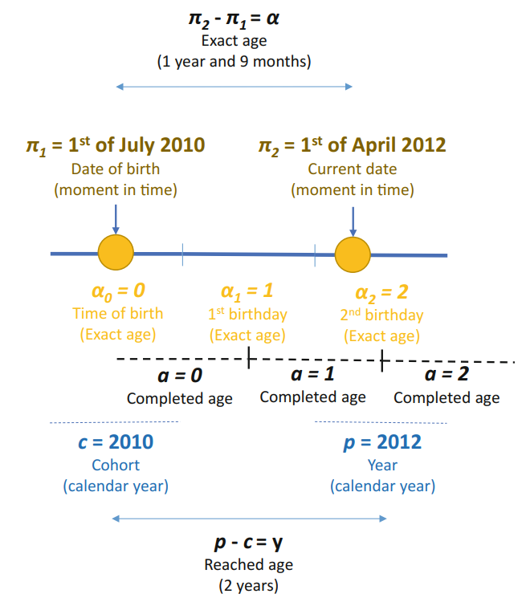
Time in Demography
Calendar (time of observation)
Age (time duration from the initial to the studied event)
Completed age
Reached age
Exact age
Cohort (time of the initial event)
Schema of the example of completed, exact, and reached age, moments of time and time intervals [1] →
Example: Todays date: 9. 11. 2022
Age of a person born on 8. 11. 2000 is
22 years and 1 day (exact age)
22 years (completed age)
22 years (reached age)
Age of a person born on 10. 11. 2000 is
21 years and 364 days (exact age)
21 years (completed age)
22 years (reached age)
p calender time (period)
c cohort
y age (years) reached
a age completed
α exact age
π particular moment in time
σ moment of birth

Slide 8
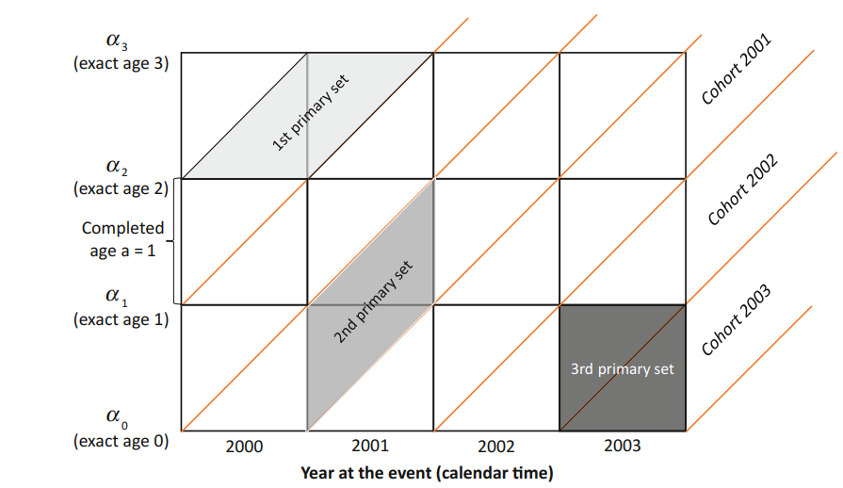
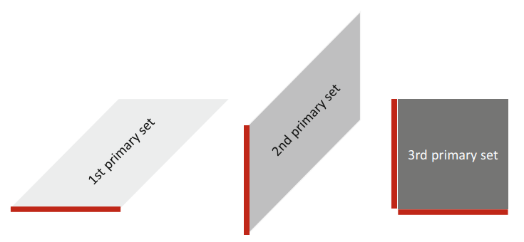
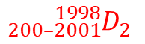
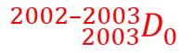
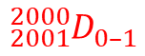

Lexis diagram – sets of events
$${{}_{200–2001}^{1998}D}_{2}^{}$$
Sets of events in Lexis diagram [1] →
$${{}_{2001}^{2000}D}_{0–1}^{}$$
$${{}_{2003}^{2002–2003}D}_{0}^{}$$
Standard notation:
$${{}_{period}^{cohort}D}_{age}^{\begin{aligned}another \\ attribute\end{aligned}}$$

Slide 9
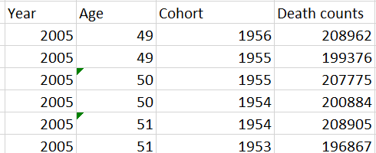
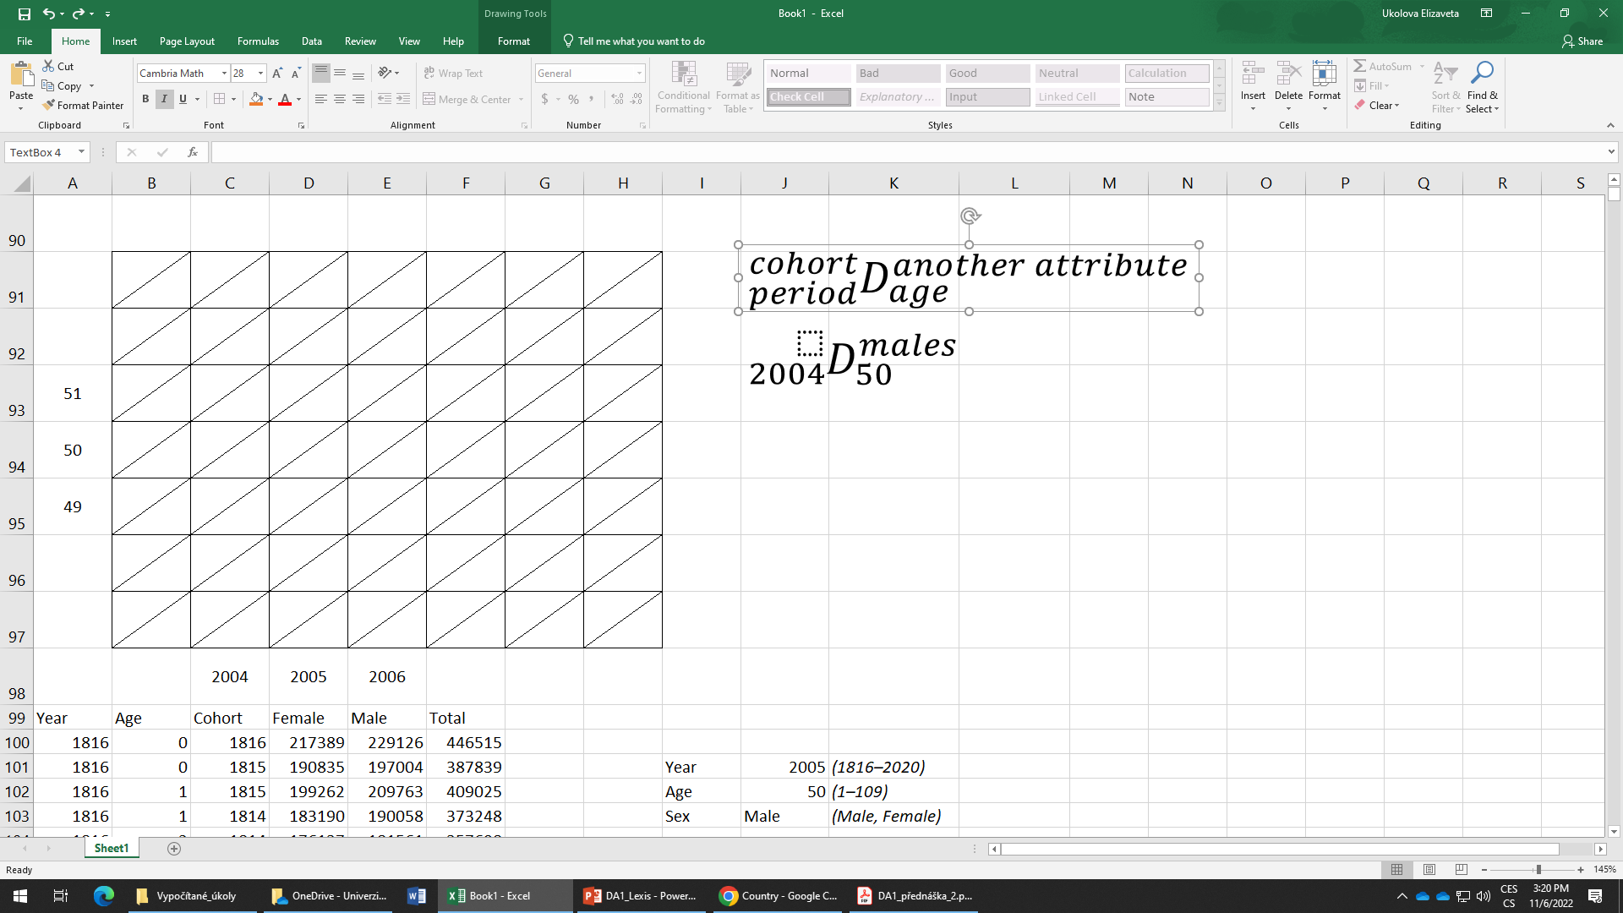
Lexis diagram – sets of events
If sets are defined by a unique period, cohort and age, we than talk about the elementary sets of events.
196 867
U…upper elementary set
L… lower elementary set
208 905
Age
(x)
U
200 884
L
207 775
199 376
U
208 962
L
U
L
Calender time (t)

Slide 10
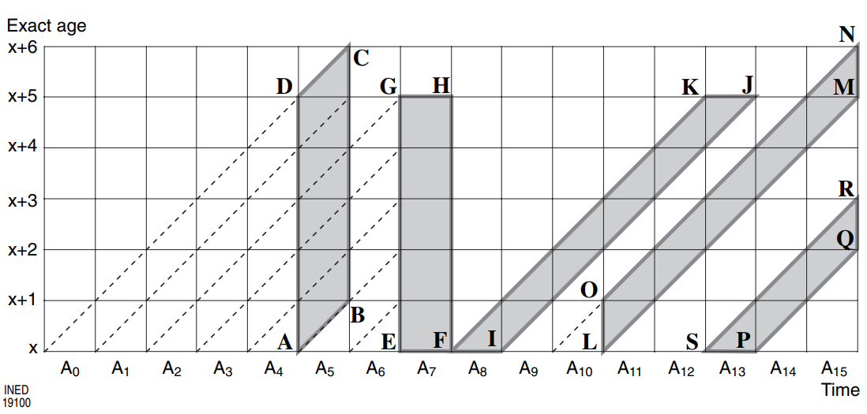
Approaches to demographic analysis
Longitudinal analysis
Cross-sectional analysis
Longitudinal analysis: We follow and analyse a single cohort throughout their lives (analysis by cohort, on a same sample).
Cross-sectional analysis: We analyse distinct cohorts during a year (or multiple years) (analysis by calendar year, on different samples).

Slide 11
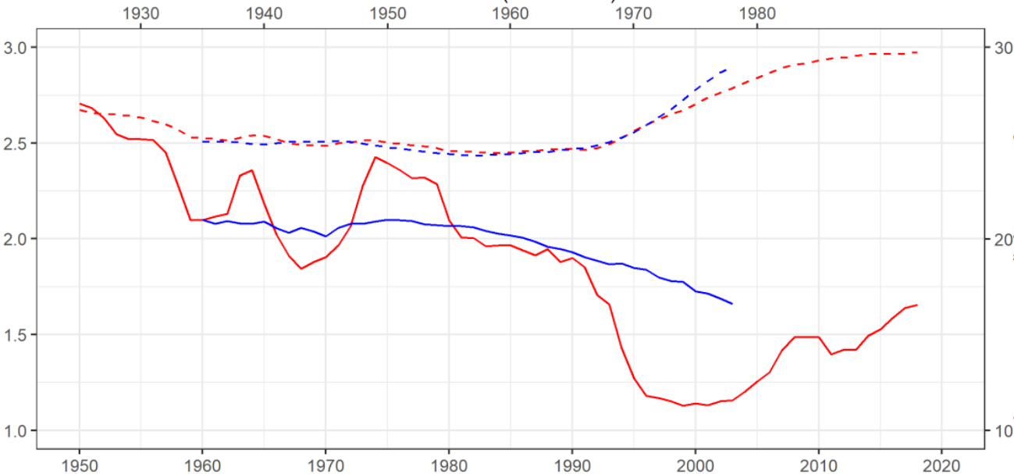
Approaches to demographic analysis
Depending on whether we apply longitudinal or cross-sectional approach, we obtain different results, in terms of interpretation as well as quantity of the measures.
Generation ~ birth cohort (blue line)
Total fertility rate (solid line)
Mean age at birth (dashed line)
Calendar year (red line)
Period and cohort-specific (cross-sectional) trends in fertility in Czechia [3]

Slide 12
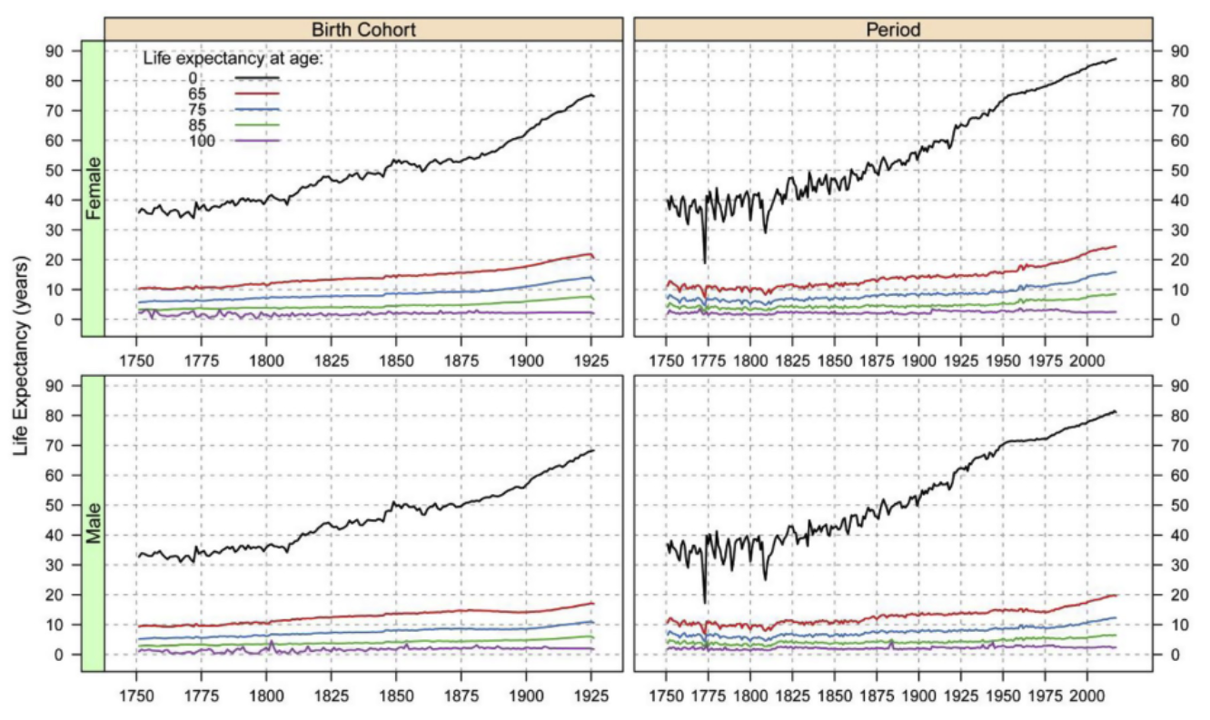
Approaches to demographic analysis
Period and cohort-specific (cross-sectional) trends in life expectancy in high income countries [4]

Slide 13
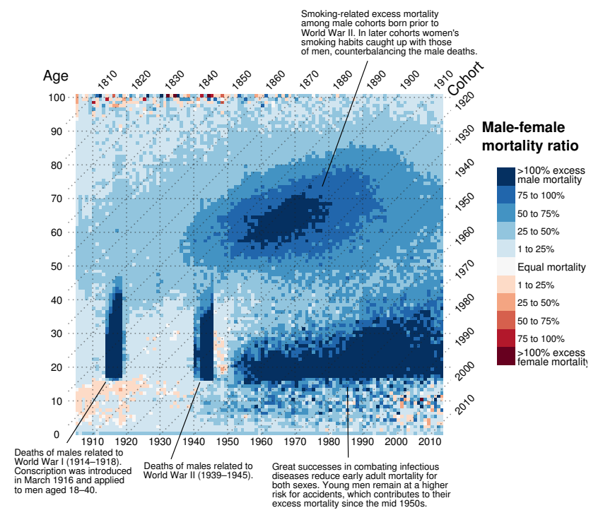
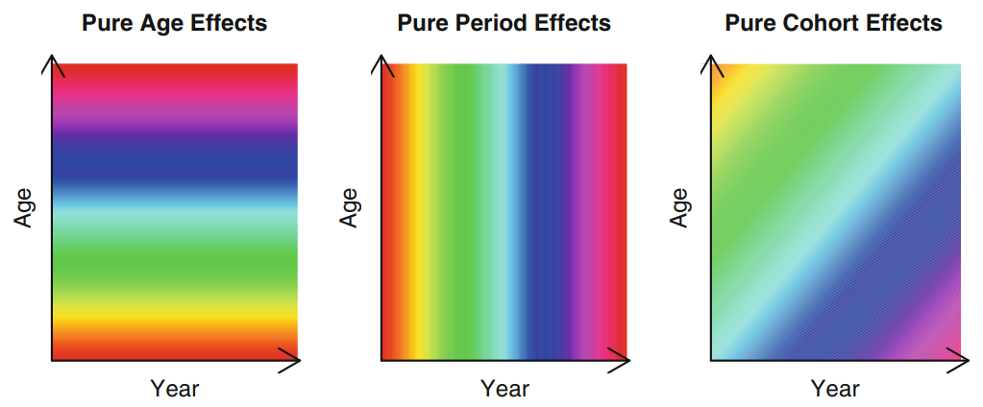
Approaches to demographic analysis
← Lexis surface plot as a tool to identify age, period and cohort effects. Ratio between male and female age-specific mortality rates in England and Wales, 1841–2013 [5]
“Ideal” age-, period-, and cohort-effects on the Lexis surface [6] ↓

Slide 14
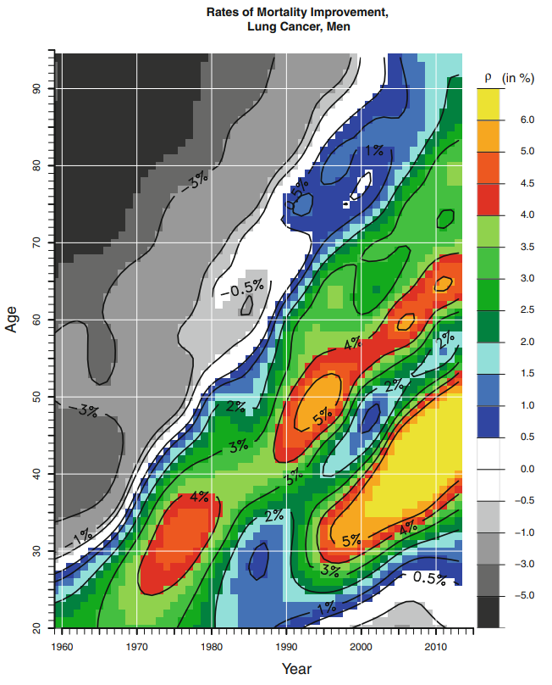
Approaches to demographic analysis
Rates of mortality improvement for lung cancer for men in the United States aged 20– 95 between 1959 and 2013 [6] →

Slide 15
Exercise 1
a. Draw to the Lexis diagram population of males at ages 20, 21, 22 and 23 years to the date 1. 1. 2014.
b. Draw to the Lexis diagram population of females at ages 20, 21, 22 and 23 years to the date 1. 7. 2014.
c. Draw to the Lexis diagram population living at exact age 61 in years 2005, 2006 and 2007.
d. Draw to the Lexis diagram total number of births by the age of mother (ages 15, 16 and 17) in 2008.
e. Draw to the Lexis diagram number of marriages of divorced men by the time elapsed since the divorce (1, 2 and 3 years) in 1997.
g. Draw to the Lexis diagram deaths of females by age (70, 71 and 72) and cohort in 2014.
h. Draw to the Lexis diagram number of divorces in 2005 by the length of duration of marriage (0, 1 and 2 years) and by the year of marriage.
i. Draw to the Lexis diagram deaths by 5-year age groups (30–34, 35–39, 40–44) in 2006.
m. Draw to the Lexis diagram number of male infant deaths by age (0, 1, 2 and 3 months) in 2010.
n. Draw to the Lexis diagram male population by age (0, 1–4) to 1.7.2000 and 1.7.2001.
r. Draw to the Lexis diagram number of marriages in 1997 by the birth cohort of a bride (1978, 1979, 1980).

Slide 16
Lexis diagram – sets of (event) points
2nd set of (event) points
1st set of points is a set of individuals being exactly x years old during a single year
2nd set of points is a set of individuals being x years of reached age on exact date
2. set of events refers to age reached during a year
3’
2
2’
1
1’
0
1st set of (event) points
0’
2019
2020
2021
2022
31.12. 2019
31.12. 2020
31.12. 2021
31.12. 2022

Slide 17
Lexis diagram – estimations of initial population and exposures
To calculate demographic measures (probabilities, rates, indices…) we need to estimate the initial population size or the population exposed (f. e. the mid-year population) to the occurrence of the event.
For each type of set of events, the initial population size, as well as the exposed population is defined differently.
Lexis diagram is helpful to depict the initial population or population exposure in accordance with the sets of events.

Slide 18
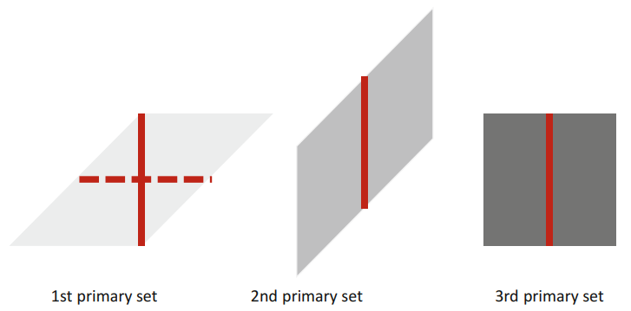
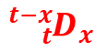
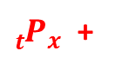
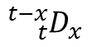
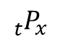
Lexis diagram – estimations of initial population and exposures
Definition of the initial population size [1] ↓
Estimation of the exposed population [1] ↓
Aritmetic means of sets of points (initial population sizes)
_{t}P_{x} population on 31.12. in year t
^{t-x}_{t}D_{x} deaths at age x, during year t, of members
of generation t-x
Estimation of the exposed population for multiple years ↓
Age
(x)
$${{}_{t}^{}P}_{x}^{}$$
$${{}_{t}^{t−x}D}_{x}^{}$$
${{}_{t}^{}P}_{x}^{}$ +
$${{}_{t}^{t−x}D}_{x}^{}$$
31. 12. 2019
31. 12. 2020
31. 12. 2021
Calender time (t)
2020
2021

Slide 19
Exercise 2
22
b.
100
105
e.
21
10 000
10 500
120
115
a.
d.
110
100
20
c.
90
95
2000
2001
2002
2003

Slide 20
Sources
[1] TESÁRKOVÁ, Klára Hulíková; KURTINOVÁ, Olga. Lexis in Demography. Springer International Publishing, 2018. Pages 11–14 & 46–48.
[2] CASELLI, Graziella; VALLIN, Jacques; WUNSCH, Guillaume. Demography: Analysis and Synthesis, Four Volume Set: A Treatise in Population. Elsevier, 2005. Part II, Chapter 6, pages 55–61.
[3] SLABÁ, Jitka. Časování plodnosti napříč generacemi českých žen narozených v letech 1966-1990. Praha, 2021. Dizertační práce. Univerzita Karlova, Přírodovědecká fakulta, Katedra demografie a geodemografie. Vedoucí práce Kocourková, Jiřina.
[4] BELTRÁN-SÁNCHEZ, Hiram; SUBRAMANIAN, S. V. Period and cohort-specific trends in life expectancy at different ages: Analysis of survival in high-income countries. SSM-population health, 2019, 8: 100422.
[5] SCHÖLEY, Jonas; WILLEKENS, Frans. Visualizing compositional data on the Lexis surface. Demographic Research, 2017, 36: 627-658.
[6] RAU, Roland, et al. Visualizing mortality dynamics in the Lexis diagram. 2017. Online: https://link.springer.com/content/pdf/10.1007/978-3-319-64820-0.pdf

